Slide 1

Interactive 3D Experience
Lesson 5:
Interacting with Objects in AR
Elyas Chua-Aziz
cel9@np.edu.sg
Diploma in IM
October 2021

Slide 2
Interacting with AR objects
Now that we have a populated AR scene, we will want to allow our users to interact with the objects present.
These interactions can happen either through touchscreen or UI input.
We will be covering both of those methods in today’s lesson.

Slide 3
Learning Objectives
Register Touch input from users, then store and display information of those inputs.
Use the Touch inputs to determine whether the user has tapped on a 3D object.
Create interactions between AR 3D objects and our users by using UI.

Slide 4
Touch Interactions
To handle touchscreen input, we will use the Touch struct from the Input class.
We have used the Input class for keyboard and mouse presses in our I3E module last semster.
E.g. Input.GetKey(Keycode.E); Input.GetMouseButton(1); etc. etc.
A struct is similar to a class in that it can hold variables and functions, with the main differences being:
Structs cannot be applied to a GameObject to create an instance of it.
Structs do not support the concept of inheritance.
Structs cannot be null.

Slide 5
Touch Struct
The Touch struct holds many properties, but we will be looking at the more vital ones which are:
Touch.tapCount
The number of taps for this Touch
Tells you if it was a double/triple tap.
Touch.position
The position of the Touch recorded on the touchscreen. This is in pixel coordinates.
Touch.phase
The phase of the Touch.
This lets you know whether the Touch just started, is being held, or has ended.
Other properties of the struct can be found in the Scripting Reference.
https://docs.unity3d.com/ScriptReference/Touch.html

Slide 6

Getting Touches
To get the touch inputs, we will use the Input.GetTouch() function.
This function requires you to pass in an int.
This line will return the first touch on a screen.
The int will be the index of the Touch that you want to get.
If the object in your application is waiting for a tap, you would pass in ‘0’ to get the first touch on the screen. ‘1’ will give you the second touch, ‘2’ will be the third, and so on so forth.
If you have a feature that requires your user to perform a ‘zoom’ action (two fingers moving away from each other), you would want to pass in ‘0’ to get and store the first Touch, and then ‘1’ to get and store the second Touch.
You could then compare the distance between these two Touches over time to determine how much to zoom.
Let’s start creating a class to track touch input from our users.

Slide 7
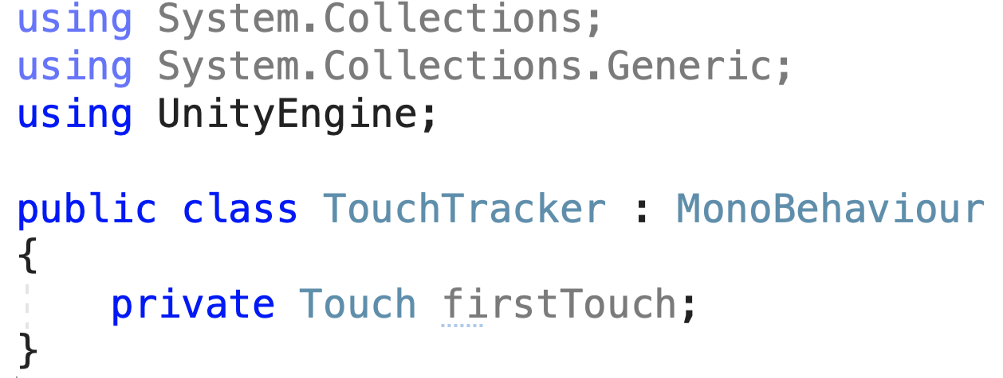
Getting Touches
We will first create a ‘Touch’ type variable.
This will be used to store the first Touch registered on a screen.
Before we can start storing a Touch in our ‘firstTouch’ variable, we must first find out whether there are even any touches.
We will use Input.touchCount to do this check.

Slide 8
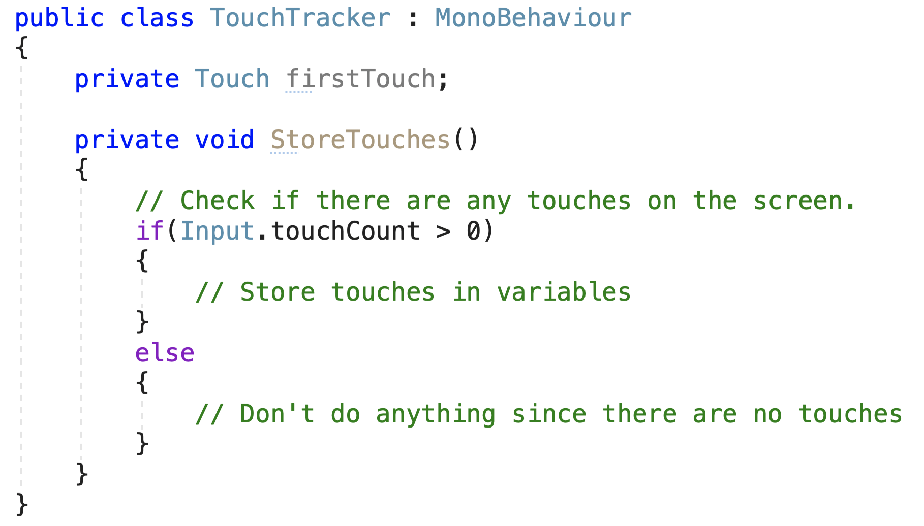
Getting Touches
The Input.touchCount property lets us know how many touches are occurring on our screen.
If it is more than 0, that means a touch is detected, and we should do something about it.
Using an if…else statement, we will check if any touch input is detected and store those touches accordingly.

Slide 9
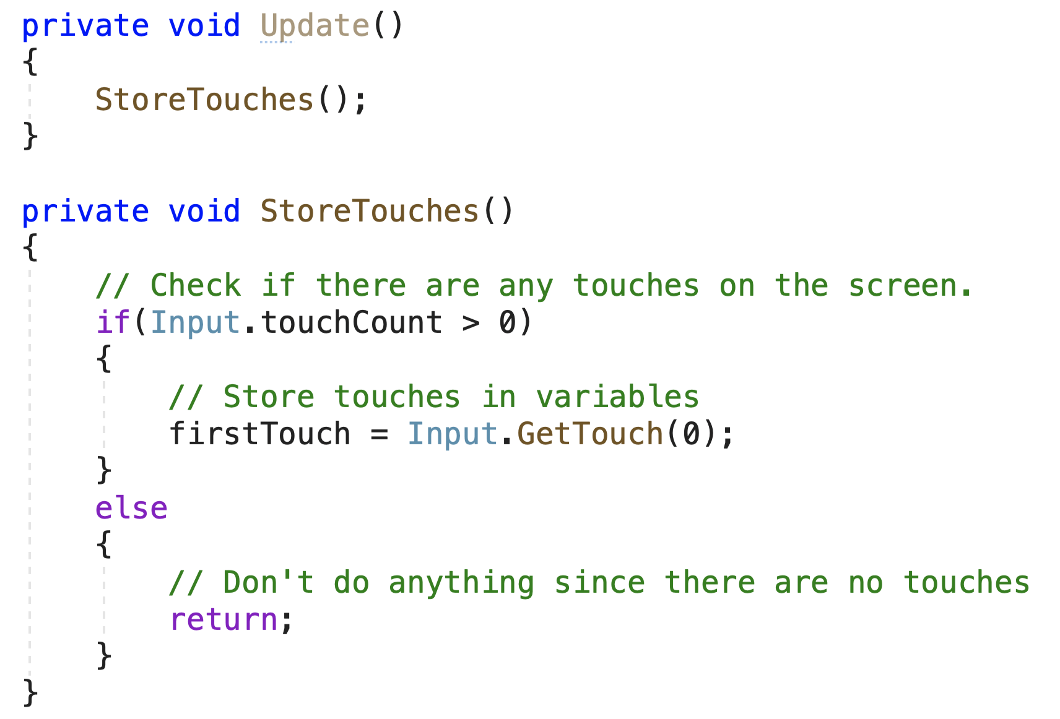
Getting Touches
We can then assign the value returned to us from Input.GetTouch(0) into the ‘firstTouch’ variable.
Recall that index 0 gives us the first touch detected on our screens.
The StoreTouches() function can then be called in an Update() function so that the checking and assigning will be done every frame.

Slide 10
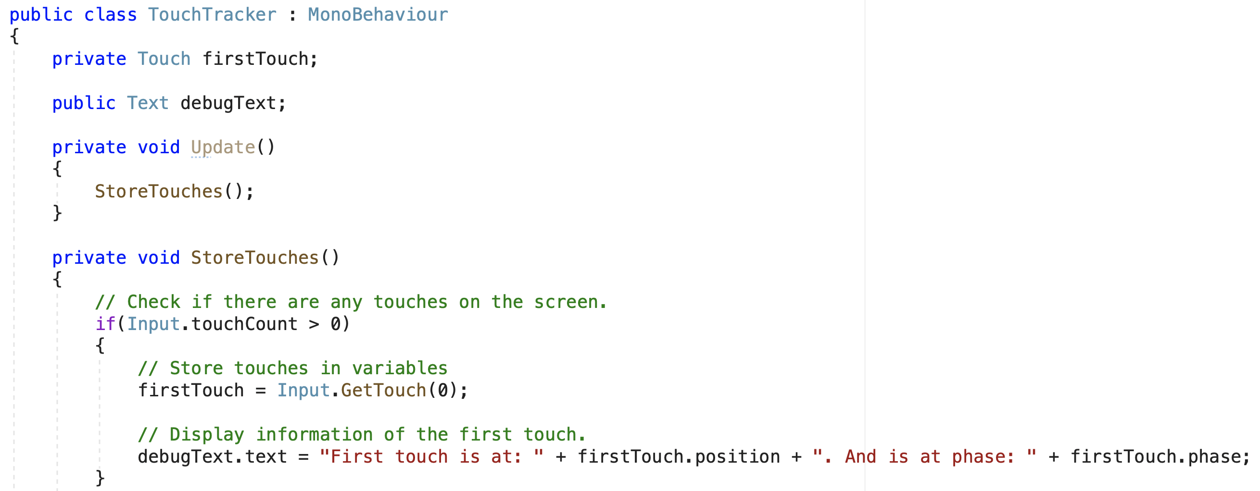
Getting Touches
With the touch input saved, we can now retrieve information (e.g. position, phase, etc.) from it.
For now, we will only display this information to show that the touch is registered.

Slide 11
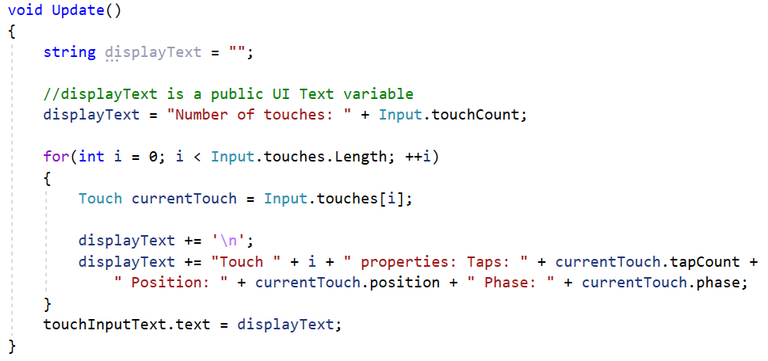
Getting Touches
Alternatively, we can get ALL the touches detected by using Input.touches.
Input.touches gives us an array of Touch structs.
With the touch input(s) stored, we can now access its information.
This sample code shows how we can display all detected touches and their properties in an Update() function.

Slide 12
Demo Time!

Slide 13
Your turn!
Create a Canvas with a UI Text object on it.
Have the UI Text display at least the position information of a single Touch input detected on your screen.
This information must be updated if the Touch input moves across the screen.
Record a short video of the Text displaying the information and updating the information as the Touch input moves.
Add the video to this set of Google Slides here:
https://docs.google.com/presentation/d/1DIRcNe6iRtrfOObmFBFyOKuJousd0zDeCNs6ve2plwk/edit?usp=sharing
Use the same slide as the previous exercise
BONUS:
Have the Text display information of MULTIPLE Touches simultaneously.

Slide 14
Using Touches
Now that we can get and store Touches, as well as access their information, we can start having our objects react to them.
To know whether our users are tapping on our objects, we will use Raycasting.

Slide 15
Using Touches
In our previous experience with Raycasting, we set the “head” of our player as the origin of the ray.
The ray would then be cast for a set distance to check if it hit any colliders.
We would then take that information and act on it if the ‘Interact’ button was pressed.
This time, the origin of our ray will be where our user taps.
To achieve this, we will use the Camera.ScreenPointToRay() function.

Slide 16

Using Touches
To use the function, you have to let Unity know which camera you want to use.
We will typically use Camera.main.ScreenPointToRay()
Think of Camera.main as a static Camera instance.
You can set which a main Camera by assigning the ‘MainCamera’ tag to it in Unity.
The Camera.ScreenPointToRay() function requires a Vector3 variable to be passed in.
This Vector3 should be the position on the screen where the user has tapped.
You can access this from the Touch Struct.
This function will return you a Ray variable.
You can choose to either store this in a variable, or pass in the entire function when using the Physics.Raycast() function.

Slide 17
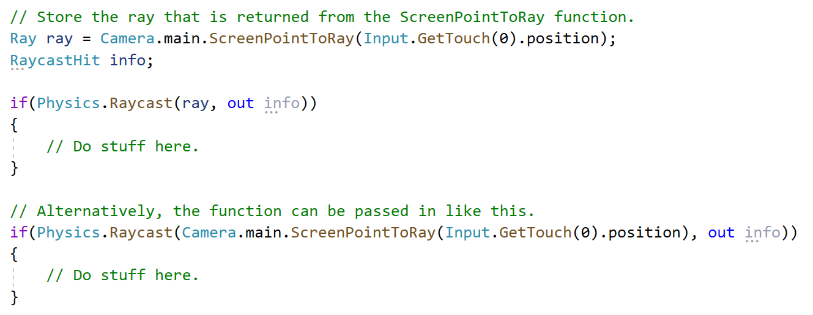
Using Touches
The same result is achieved regardless of which method is used, just that storing the returned Ray variable makes our code look a little cleaner.

Slide 18
Using Touches
With the Raycast, we can check if our users are tapping on any 3D objects in the scene.
We can then have our objects react accordingly.
The logic flow is similar to how our 3D player interacts with objects, just that the player is now an actual person.
We might also want our object to react depending on what kind of touch is happening.
Is the touch being held?
Is the touch moving?
Has the touch ended?
We will use the Touch.phase property to check what kind of touch input is being received.

Slide 19
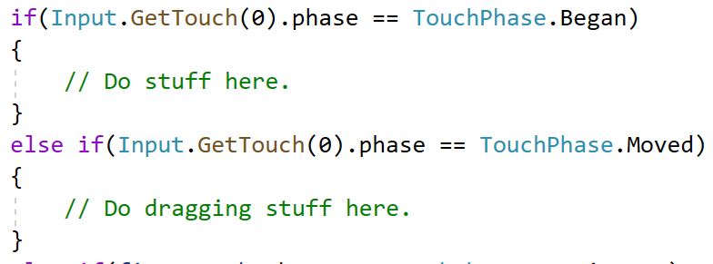
Using Touches
The Touch.phase property is a TouchPhase type enum.
To check it, we will do this:

Slide 20
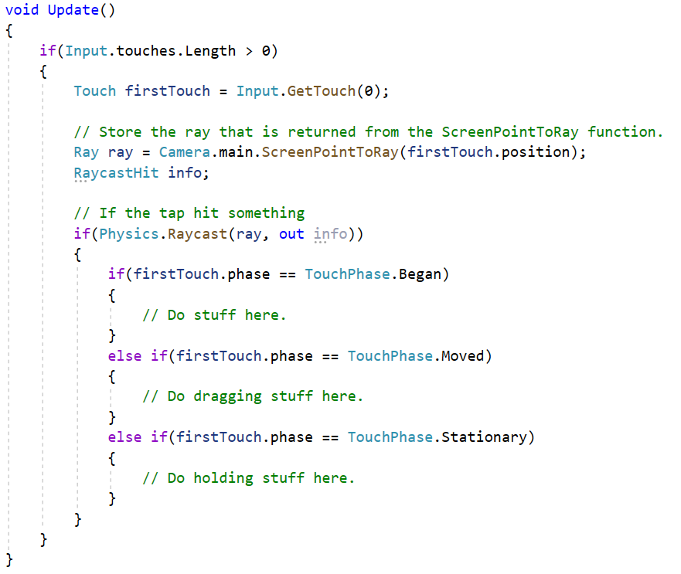
Using Touches
Combining it all, we will now be able to allow our users to interact with 3D objects through touchscreen input.
Having touch inputs in your application will greatly increase the immersion and fun of it, so be sure to make full use of it.

Slide 21
Demo Time!

Slide 22
Your turn!
Instead of displaying the Touch input information, have the UI Text display the name of the 3D object the user taps on.
Use all 3 Image Targets from last week.
Remember to add Colliders to your objects!
Record a short video of the Text displaying the information and updating when tapping on a different object.
Add the video to this set of Google Slides here:
https://docs.google.com/presentation/d/1DIRcNe6iRtrfOObmFBFyOKuJousd0zDeCNs6ve2plwk/edit?usp=sharing
Use the same slide as the previous exercise
BONUS:
Have the 3D objects react to the tap in same fashion.
E.g. changing scale/position/rotation

Slide 23
UI Input Interactions
Interacting with our AR objects through UI is one of the simpler methods to implement interaction as most of the work is handled by Unity.
We can create a basic form of interaction by linking a UI Button to a function in a class that tells our objects to perform certain actions.
E.g. changing color, playing an animation, moving to a target, etc. on button press.
Let’s look at how we can make our astronaut object play an animation when a UI Button is pressed.

Slide 24
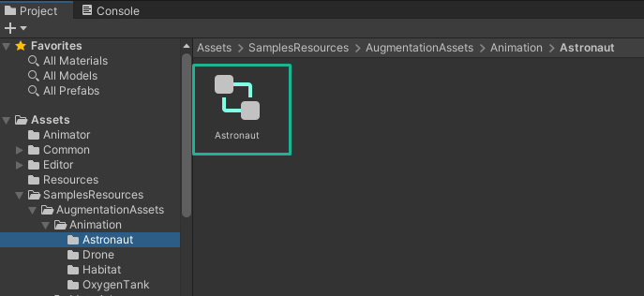
UI Input Interactions
Let’s first add an animation to our astronaut.
Look for the ‘Astronaut’ Animator Controller in the Vuforia samples.

Slide 25
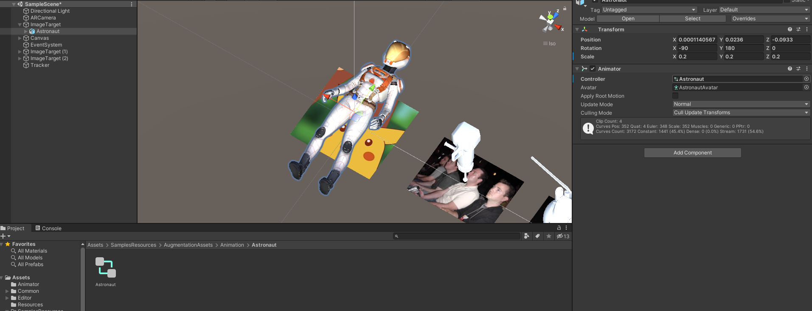
UI Input Interactions
Select the ‘Astronaut’ object in your ImageTarget, then drag and drop the Controller to the Animator component.

Slide 26
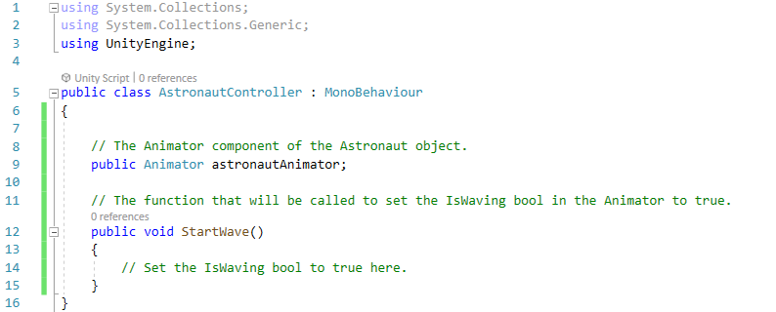
UI Input Interactions
In the class, include:
A public Animator variable to link the Animator component of the astronaut.
A public function to set the ‘IsWaving’ bool of the Animator to true.
Once you have those set up, we can go back to the Unity project.

Slide 27
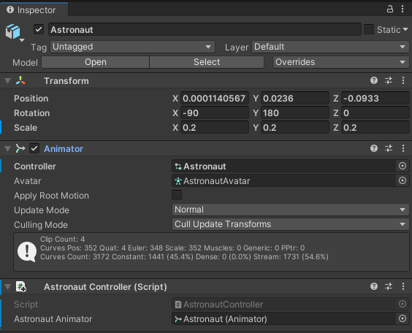
UI Input Interactions
With the astronaut object selected, add the ‘AstronautController’ script, and drag the Animator component to the empty field.

Slide 28
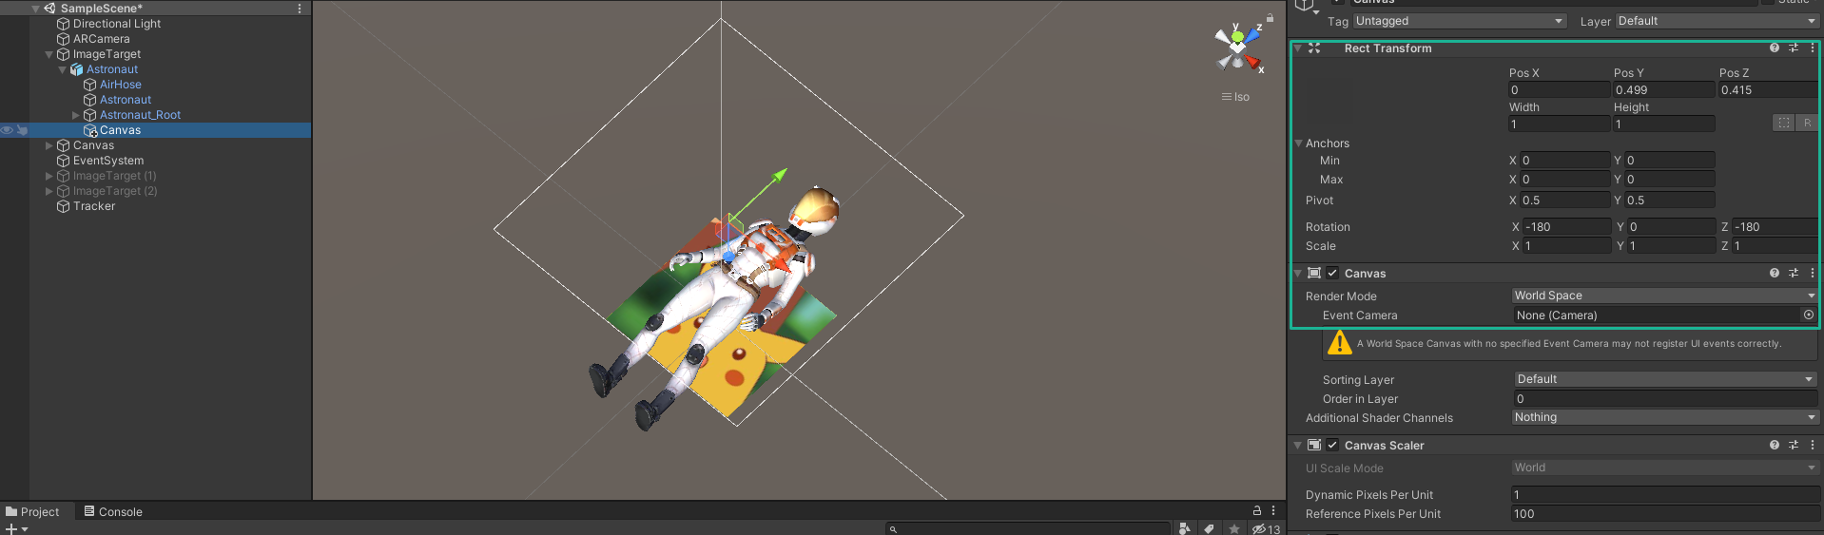
UI Input Interactions
Create a World Space Canvas as a child of the astronaut object.
Refer to the image below for the ideal RectTransform values.

Slide 29
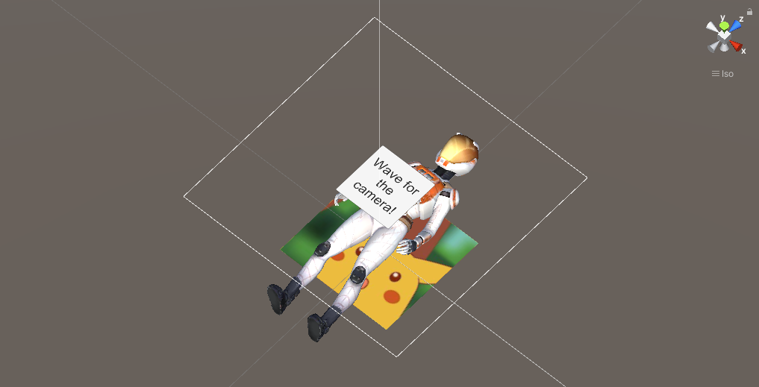
UI Input Interactions
Create a UI Button on the Canvas like this:
Now, we are left with linking the function of our class to the OnClick event of this Button.

Slide 30
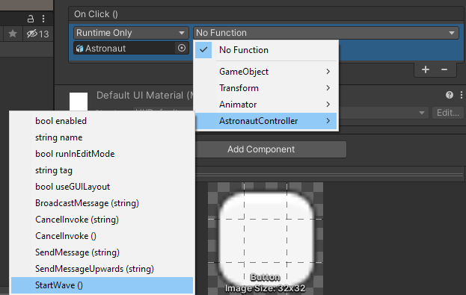
UI Input Interactions
Select the UI Button and link the Astronaut object to the OnClick event.
Look for the ‘StartWave’ function in the AstronautController component and select it.
The astronaut should now be ready to wave for the camera once the button is clicked!

Slide 31
Demo Time!

Slide 32
Your turn!
Set up your Astronaut object with some animations.
Create a function in a new class that makes the Astronaut play those animations.
Link that function to a UI Button.
Take a screenshot or short video (good practice for Asg1), and upload it here: https://docs.google.com/presentation/d/1DIRcNe6iRtrfOObmFBFyOKuJousd0zDeCNs6ve2plwk/edit?usp=sharing
Use the same slide as the previous exercise
BONUS: Only have the UI Button appear after tapping on the Astronaut object.
Hint: Combine the Touch inputs to make this happen.

Slide 33
Summary
Using Touch input from Unity, we can register and save taps from users on a touchscreen.
We can then access information of those taps and display them, or use them to drive our interactions with AR 3D objects.
Aside from using taps, we can also make use of the UI system in Unity to create user interactions with AR objects.

